Slide 1
Introducing Information Retrieval
and Web Search

Slide 2
Information Retrieval
Information Retrieval (IR) is finding material (usually documents) of an unstructured nature (usually text) that satisfies an information need from within large collections (usually stored on computers).
These days we frequently think first of web search, but there are many other cases:
E-mail search
Searching your laptop
Corporate knowledge bases
Legal information retrieval

Slide 3
Basic assumptions of Information Retrieval
Sec. 1.1
Collection: A set of documents
Assume it is a static collection for the moment
Goal: Retrieve documents with information that is relevant to the user’s information need and helps the user complete a task

Slide 4
The classic search model
User task
Info need
Query
Search
engine
Query refinement
Results
Collection

Slide 5
Introducing Information Retrieval
and Web Search

Slide 6
Term-document incidence matrices

Slide 7
Unstructured data in 1620
Sec. 1.1
Which plays of Shakespeare contain the words Brutus AND Caesar but NOT Calpurnia?
Notes:
Grep is line-oriented; IR is document oriented.

Slide 8
Term-document incidence matrices
Sec. 1.1
1 if play contains word, 0 otherwise
Brutus AND Caesar BUT NOT Calpurnia

Slide 9
Incidence vectors
Sec. 1.1
So we have a 0/1 vector for each term.
To answer query: take the vectors for Brutus, Caesar and Calpurnia (complemented) ➔ bitwise AND.
110100 AND
110111 AND
101111 =
100100

Slide 10
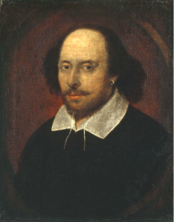
Answers to query
Sec. 1.1
Antony and Cleopatra, Act III, Scene ii
Agrippa [Aside to DOMITIUS ENOBARBUS]: Why, Enobarbus,
When Antony found Julius Caesar dead,
He cried almost to roaring; and he wept
When at Philippi he found Brutus slain.
Hamlet, Act III, Scene ii
Lord Polonius: I did enact Julius Caesar I was killed i’ the
Capitol; Brutus killed me.
Notes:
Wikimedia commons picture of Shake

Slide 11
Bigger collections
Sec. 1.1
Consider N = 1 million documents, each with about 1000 words.
Avg 6 bytes/word including spaces/punctuation
6GB of data in the documents.
Say there are M = 500K distinct terms among these.

Slide 12
Can’t build the matrix
Sec. 1.1
500K x 1M matrix has half-a-trillion 0’s and 1’s.
But it has no more than one billion 1’s.
matrix is extremely sparse.
What’s a better representation?
We only record the 1 positions.
Why?

Slide 13
Term-document incidence matrices

Slide 14
The Inverted Index
The key data structure underlying modern IR

Slide 15
Inverted index
Sec. 1.2
For each term t, we must store a list of all documents that contain t.
Identify each doc by a docID, a document serial number
Can we used fixed-size arrays for this?
Brutus
1
2
4
11
31
45
173
174
Caesar
1
2
4
5
6
16
57
132
Calpurnia
2
31
54
101
What happens if the word Caesar is added to document 14?

Slide 16
Inverted index
Sec. 1.2
We need variable-size postings lists
On disk, a continuous run of postings is normal and best
In memory, can use linked lists or variable length arrays
Some tradeoffs in size/ease of insertion
Posting
Brutus
1
2
4
11
31
45
173
174
Caesar
1
2
4
5
6
16
57
132
Calpurnia
2
31
54
101
Dictionary
Postings
Sorted by docID (more later on why).
Notes:
Linked lists generally preferred to arrays
Dynamic space allocation
Insertion of terms into documents easy
Space overhead of pointers

Slide 17

Inverted index construction
Sec. 1.2
Documents to
be indexed
Friends, Romans, countrymen.
Tokenizer
Token stream
Friends
Romans
Countrymen
Linguistic modules
Modified tokens
friend
roman
countryman
Indexer
friend
2
4
roman
1
2
Inverted index
countryman
13
16
Notes:
Document icons from free icon set: http://www.icojoy.com/articles/44/

Slide 18
Inverted index construction
Sec. 1.2
Documents to
be indexed
Friends, Romans, countrymen.
Tokenizer
Token stream
Friends
Romans
Countrymen
More on
these later.
Linguistic modules
Modified tokens
friend
roman
countryman
Indexer
friend
2
4
roman
1
2
Inverted index
countryman
13
16
Notes:
Document icons from free icon set: http://www.icojoy.com/articles/44/

Slide 19
Initial stages of text processing
Tokenization
Cut character sequence into word tokens
Deal with “John’s”, a state-of-the-art solution
Normalization
Map text and query term to same form
You want U.S.A. and USA to match
Stemming
We may wish different forms of a root to match
authorize, authorization
Stop words
We may omit very common words (or not)
the, a, to, of

Slide 20
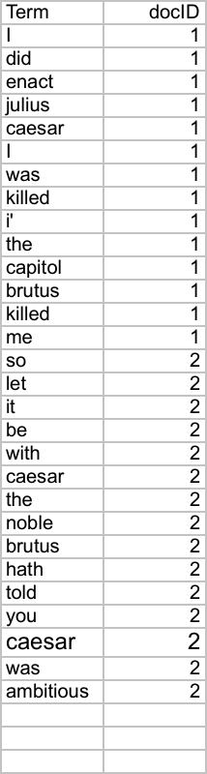
Indexer steps: Token sequence
Sec. 1.2
Sequence of (Modified token, Document ID) pairs.
Doc 1
Doc 2
I did enact Julius
Caesar I was killed
i’ the Capitol;
Brutus killed me.
So let it be with
Caesar. The noble
Brutus hath told you
Caesar was ambitious

Slide 21
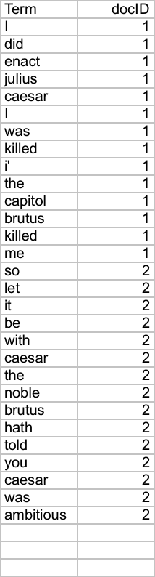
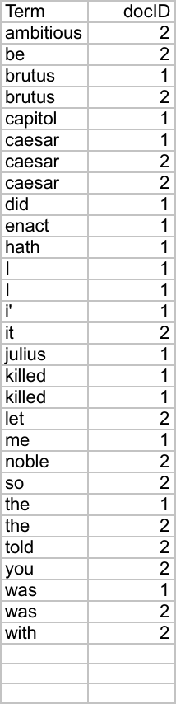
Indexer steps: Sort
Sec. 1.2
Sort by terms
And then docID
Core indexing step

Slide 22
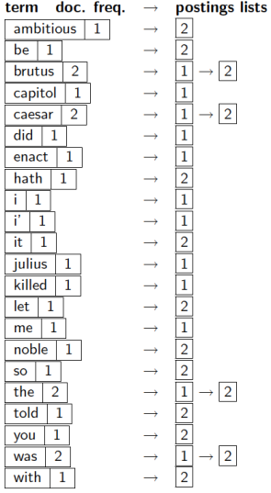
Indexer steps: Dictionary & Postings
Sec. 1.2
Multiple term entries in a single document are merged.
Split into Dictionary and Postings
Doc. frequency information is added.
Why frequency?
Will discuss later.

Slide 23
Where do we pay in storage?
Sec. 1.2
Lists of docIDs
Terms and counts
IR system implementation
How do we index efficiently?
How much storage do we need?
Pointers

Slide 24
The Inverted Index
The key data structure underlying modern IR

Slide 25
Query processing with an inverted index

Slide 26
The index we just built
Sec. 1.3
How do we process a query?
Later - what kinds of queries can we process?
Our focus

Slide 27
Query processing: AND
Sec. 1.3
Consider processing the query:
Brutus AND Caesar
Locate Brutus in the Dictionary;
Retrieve its postings.
Locate Caesar in the Dictionary;
Retrieve its postings.
“Merge” the two postings (intersect the document sets):
2
4
8
16
32
64
128
Brutus
1
2
3
5
8
13
21
34
Caesar

Slide 28
The merge
Sec. 1.3
Walk through the two postings simultaneously, in time linear in the total number of postings entries
2
4
8
16
32
64
128
Brutus
1
2
3
5
8
13
21
34
Caesar
If the list lengths are x and y, the merge takes O(x+y)
operations.
Crucial: postings sorted by docID.

Slide 29
The merge
Sec. 1.3
Walk through the two postings simultaneously, in time linear in the total number of postings entries
2
2
4
4
8
8
16
16
32
64
128
32
64
128
Brutus
2
8
1
Caesar
1
2
2
3
5
5
8
8
13
13
21
21
34
3
34
If the list lengths are x and y, the merge takes O(x+y)
operations.
Crucial: postings sorted by docID.

Slide 30
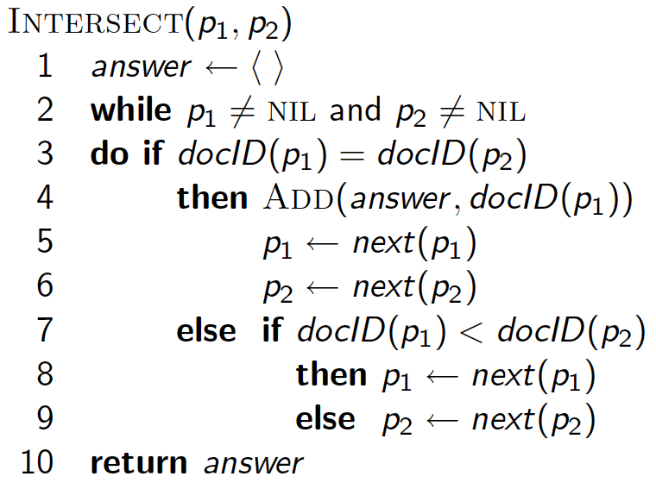
Intersecting two postings lists (a “merge” algorithm)

Slide 31
Query processing with an inverted index

Slide 32
Introducing ranked retrieval

Slide 33
Ranked retrieval
Ch. 6
Thus far, our queries have all been Boolean.
Documents either match or don’t.
Good for expert users with precise understanding of their needs and the collection.
Also good for applications: Applications can easily consume 1000s of results.
Not good for the majority of users.
Most users incapable of writing Boolean queries (or they are, but they think it’s too much work).
Most users don’t want to wade through 1000s of results.
This is particularly true of web search.

Slide 34
Problem with Boolean search: feast or famine
Ch. 6
Boolean queries often result in either too few (≈0) or too many (1000s) results.
Query 1: “standard user dlink 650” → 200,000 hits
Query 2: “standard user dlink 650 no card found” → 0 hits
It takes a lot of skill to come up with a query that produces a manageable number of hits.
AND gives too few; OR gives too many
Notes:
Cf. our discussion of how Westlaw Boolean queries didn’t actually outperform free text querying

Slide 35
Ranked retrieval models
Rather than a set of documents satisfying a query expression, in ranked retrieval models, the system returns an ordering over the (top) documents in the collection with respect to a query
Free text queries: Rather than a query language of operators and expressions, the user’s query is just one or more words in a human language
In principle, there are two separate choices here, but in practice, ranked retrieval models have normally been associated with free text queries and vice versa

Slide 36
Scoring as the basis of ranked retrieval
Ch. 6
We wish to return in order the documents most likely to be useful to the searcher
How can we rank-order the documents in the collection with respect to a query?
f(d,q)
Assign a score – say in [0, 1] – to each document
This score measures how well document and query “match”.

Slide 37
Query-document matching scores
Ch. 6
We need a way of assigning a score to a query/document pair
Let’s start with a one-term query
If the query term does not occur in the document: score should be 0
The more frequent the query term in the document, the higher the score (should be)
We will look at a number of alternatives for this

Slide 38
Introducing ranked retrieval

Slide 39
Term frequency weighting

Slide 40
Recall: Binary term-document incidence matrix
Sec. 6.2
Each document is represented by a binary vector ∈ {0,1}^{|V|}

Slide 41
Term-document count matrices
Sec. 6.2
Consider the number of occurrences of a term in a document:
Each document is a count vector in ℕ^{|V|}: a column below
Notes:
Underline count vector and circle a vector!

Slide 42
Term-document count matrices
Sec. 6.2
Consider the number of occurrences of a term in a document:
Each document is a count vector in ℕ^{|V|}: a column below

Slide 43
Bag of words model
Vector representation doesn’t consider the ordering of words in a document
John is quicker than Mary and Mary is quicker than John have the same vectors
This is called the bag of words model.

Slide 44
Term frequency tf
The term frequency tf_{t,d} of term t in document d is defined as the number of times that t occurs in d.
We want to use tf when computing query-document match scores. But how?
Raw term frequency is not what we want:
A document with 10 occurrences of the term is more relevant than a document with 1 occurrence of the term.
But not 10 times more relevant.
Relevance does not increase proportionally with term frequency.

Slide 45
Log-frequency weighting
Sec. 6.2
The log frequency weight of term t in d is
Score for a document-query pair: sum over terms t in both q and d:
score
The score is 0 if none of the query terms is present in the document.
Notes:
0 → 0, 1 → 1, 2 → 1.3, 10 → 2, 1000 → 4, etc.

Slide 46
Log-frequency weighting
Sec. 6.2
The log frequency weight of term t in d is
0 → 0, 1 → 1, 2 → 1.3, 10 → 2, 1000 → 4, etc.
Score for a document-query pair: sum over terms t in both q and d:
score
The score is 0 if none of the query terms is present in the document.

Slide 47
Term frequency weighting

Slide 48
(Inverse) Document frequency weighting

Slide 49
Document frequency
Sec. 6.2.1
Rare terms are more informative than frequent terms
Recall stop words
Consider a term in the query that is rare in the collection (e.g., arachnocentric)
A document containing this term is very likely to be relevant to the query arachnocentric
→ We want a high weight for rare terms like arachnocentric.

Slide 50
idf weight
Sec. 6.2.1
df_{t} is the document frequency of t: the number of documents that contain t
df_{t} is an inverse measure of the informativeness of t
df_{t} ≤ N
We define the idf (inverse document frequency) of t by
We use log (N/df_{t}) instead of N/df_{t} to “dampen” the effect of idf.
Will turn out the base of the log is immaterial.

Slide 51
idf example, suppose N = 1 million
Sec. 6.2.1
term | df_{t} | idf_{t}
calpurnia | 1
animal | 100
sunday | 1,000
fly | 10,000
under | 100,000
the | 1,000,000
There is one idf value for each term t in a collection.
Notes:
6 4 3 2 1 0

Slide 52
Effect of idf on ranking
Question: Does idf have an effect on ranking for one-term queries, like
iPhone

Slide 53
Effect of idf on ranking
Question: Does idf have an effect on ranking for one-term queries, like
iPhone
idf has no effect on ranking one term queries
idf affects the ranking of documents for queries with at least two terms
For the query capricious person, idf weighting makes occurrences of capricious count for much more in the final document ranking than occurrences of person.

Slide 54
Collection vs. Document frequency
Sec. 6.2.1
The collection frequency of t is the number of occurrences of t in the collection, counting multiple occurrences.
Example:
Which word is a better search term (and should get a higher weight)?
Word | Collection frequency | Document frequency
insurance | 10440 | 3997
try | 10422 | 8760
Notes:
Why do you get these numbers?
Suggests df is better.

Slide 55
(Inverse) Document frequency weighting

Slide 56
tf-idf weighting

Slide 57
tf-idf weighting
Sec. 6.2.2
The tf-idf weight of a term is the product of its tf weight and its idf weight.
Best known weighting scheme in information retrieval
Note: the “-” in tf-idf is a hyphen, not a minus sign!
Alternative names: tf.idf, tf x idf
Increases with the number of occurrences within a document
Increases with the rarity of the term in the collection

Slide 58
Final ranking of documents for a query
Sec. 6.2.2

Slide 59
Binary → count → weight matrix
Sec. 6.3
Each document is now represented by a real-valued vector of tf-idf weights ∈ R^{|V|}

Slide 60
tf-idf weighting

Slide 61
The Vector Space Model (VSM)

Slide 62
Documents as vectors
Sec. 6.3
Now we have a |V|-dimensional vector space
Terms are axes of the space
Documents are points or vectors in this space
Very high-dimensional: tens of millions of dimensions when you apply this to a web search engine
These are very sparse vectors – most entries are zero

Slide 63
Queries as vectors
Sec. 6.3
Key idea 1: Do the same for queries: represent them as vectors in the space
Key idea 2: Rank documents according to their proximity to the query in this space
proximity = similarity of vectors
proximity ≈ inverse of distance
Recall: We do this because we want to get away from the you’re-either-in-or-out Boolean model
Instead: rank more relevant documents higher than less relevant documents

Slide 64
Formalizing vector space proximity
Sec. 6.3
First cut: distance between two points
( = distance between the end points of the two vectors)
Euclidean distance?
Euclidean distance is a bad idea . . .
. . . because Euclidean distance is large for vectors of different lengths.

Slide 65
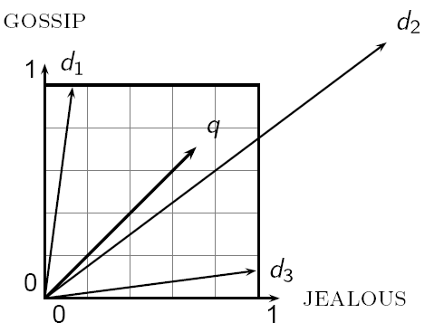
Why distance is a bad idea
Sec. 6.3
The Euclidean distance between q
and d₂ is large even though the
distribution of terms in the query q and the distribution of
terms in the document d₂ are
very similar.

Slide 66
Use angle instead of distance
Sec. 6.3
Thought experiment: take a document d and append it to itself. Call this document d′.
“Semantically” d and d′ have the same content
The Euclidean distance between the two documents can be quite large
The angle between the two documents is 0, corresponding to maximal similarity.
Key idea: Rank documents according to angle with query.

Slide 67
From angles to cosines
Sec. 6.3
The following two notions are equivalent.
Rank documents in decreasing order of the angle between query and document
Rank documents in increasing order of
cosine(query,document)
Cosine is a monotonically decreasing function for the interval [0º, 180º]

Slide 68
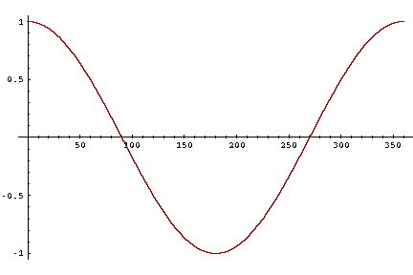
From angles to cosines
Sec. 6.3
But how – and why – should we be computing cosines?

Slide 69
Length normalization
Sec. 6.3
A vector can be (length-) normalized by dividing each of its components by its length – for this we use the L₂ norm:
Dividing a vector by its L₂ norm makes it a unit (length) vector (on surface of unit hypersphere)
Effect on the two documents d and d′ (d appended to itself) from earlier slide: they have identical vectors after length-normalization.
Long and short documents now have comparable weights

Slide 70
cosine(query,document)
Sec. 6.3
Dot product
Unit vectors
q_{i} is the tf-idf weight of term i in the query
d_{i} is the tf-idf weight of term i in the document
cos(q,d) is the cosine similarity of q and d … or,
equivalently, the cosine of the angle between q and d.
Notes:
See Law of Cosines (Cosine Rule) wikipedia page

Slide 71
Cosine for length-normalized vectors
For length-normalized vectors, cosine similarity is simply the dot product (or scalar product):
for q, d length-normalized.

Slide 72
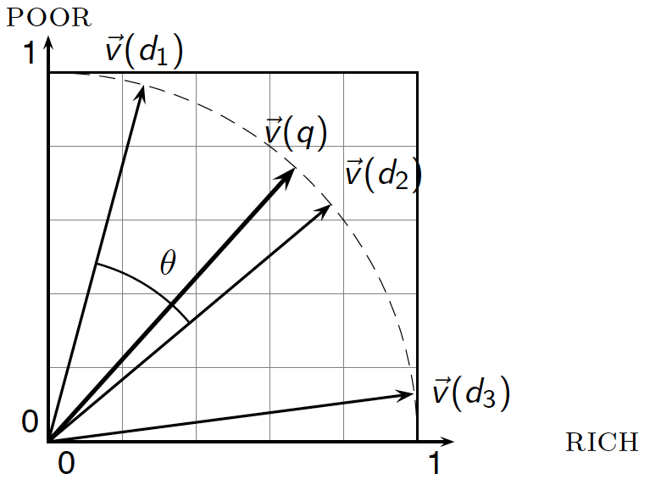
Cosine similarity illustrated

Slide 73
Cosine similarity amongst 3 documents
Sec. 6.3
How similar are
the novels
SaS: Sense and
Sensibility
PaP: Pride and
Prejudice, and
WH: Wuthering
Heights?
term | SaS | PaP | WH
affection | 115 | 58 | 20
jealous | 10 | 7 | 11
gossip | 2 | 0 | 6
wuthering | 0 | 0 | 38
Term frequencies (counts)
Note: To simplify this example, we don’t do idf weighting.

Slide 74
3 documents example contd.
Sec. 6.3
Log frequency weighting
After length normalization
term | SaS | PaP | WH
affection | 3.06 | 2.76 | 2.30
jealous | 2.00 | 1.85 | 2.04
gossip | 1.30 | 0 | 1.78
wuthering | 0 | 0 | 2.58
term | SaS | PaP | WH
affection | 0.789 | 0.832 | 0.524
jealous | 0.515 | 0.555 | 0.465
gossip | 0.335 | 0 | 0.405
wuthering | 0 | 0 | 0.588
cos(SaS,PaP) ≈
0.789 × 0.832 + 0.515 × 0.555 + 0.335 × 0.0 + 0.0 × 0.0 ≈ 0.94
cos(SaS,WH) ≈ 0.79
cos(PaP,WH) ≈ 0.69
Why do we have cos(SaS,PaP) > cos(SAS,WH)?

Slide 75
The Vector Space Model (VSM)

Slide 76
Calculating tf-idf cosine scores
in an IR system

Slide 77
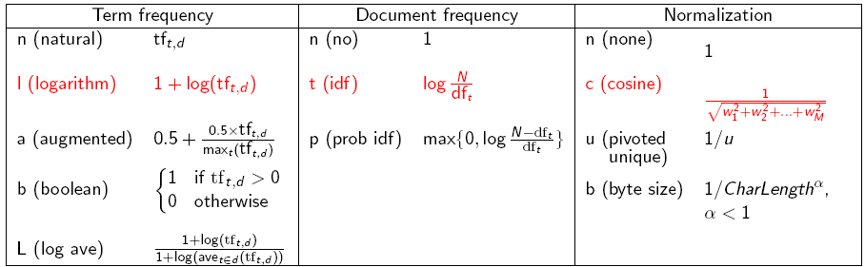
tf-idf weighting has many variants
Sec. 6.4
Columns headed ‘n’ are acronyms for weight schemes.
Why is the base of the log in idf immaterial?
Notes:
n default is just term frequency
ltc is best known form of weighting

Slide 78
tf-idf weighting has many variants
Sec. 6.4
Notes:
n default is just term frequency
ltc is best known form of weighting

Slide 79
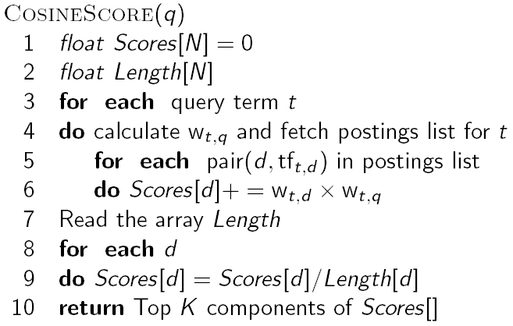
Computing cosine scores
Sec. 6.3
Notes:
Needs to be after the idea of separately weighting query and document terms.

Slide 80
Summary – vector space ranking
Represent the query as a weighted tf-idf vector
Represent each document as a weighted tf-idf vector
Compute the cosine similarity score for the query vector and each document vector
Rank documents with respect to the query by score
Return the top K (e.g., K = 10) to the user

Slide 81
Calculating tf-idf cosine scores
in an IR system

